Slide 1
Transmission media

Slide 2
OUTLINE
Transmission media overview
Types of transmission media

Slide 3
TRANSMISSION MEDIA
communication channel that carries the information from the sender to the receiver.
Data is transmitted through the electromagnetic signals.
carry the information in the form of bits through LAN.
It is a physical path between transmitter and receiver in data communication.
the bits are in the form of electrical signals for copper based
the bits are in the form of light pulses for fibre optic.

Slide 4
transmission media supports the Layer 1, so it’s a Layer 1 component.
The electrical signals can be sent through the copper wire, fibre optics, atmosphere, water, and vacuum.
The characteristics and quality of data transmission are determined by the characteristics of medium and signal.

Slide 5
TYPES OF TRANSMISSION MEDIA :
wired media(guided media)
wireless media(unguided).
In wired media, medium characteristics are vital, while in wireless media signal characteristics are vital.
TRANSMISSION MEDIA PROPERTIES
bandwidth
Delay
cost
ease of installation and maintenance.

Slide 6
FACTORS TO CONSIDER FOR A TRANSMISSION MEDIA
Bandwidth: the greater the bandwidth of a medium, the higher the data transmission rate of a signal.
Transmission impairment: When the received signal is not identical to the transmitted one due to the transmission impairment.
Interference: process of disrupting a signal when it travels over a communication medium on the addition of some unwanted signal.

Slide 7
CAUSES OF TRANSMISSION IMPAIRMENT
Attenuation: the strength of the signal decreases with increasing the distance which causes the loss of energy.
Distortion: when there is a change in the shape of the signal.
This is examined from different signals having different frequencies.
Noise: unwanted signal is added to data transmission.

Slide 8
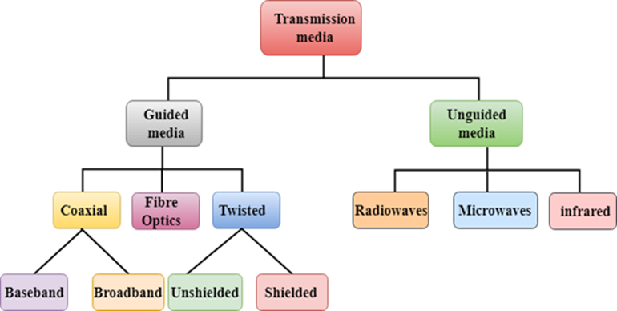
CLASSIFICATION OF TRANSMISSION MEDIA

Slide 9
TYPES OF TRANSMISSION MEDIA/CLASSIFICATION
Guided Transmission Media
UnGuided Transmission Media
GUIDED MEDIA(BOUNDED MEDIA)
It is defined as the physical medium through which the signals are transmitted.

Slide 10
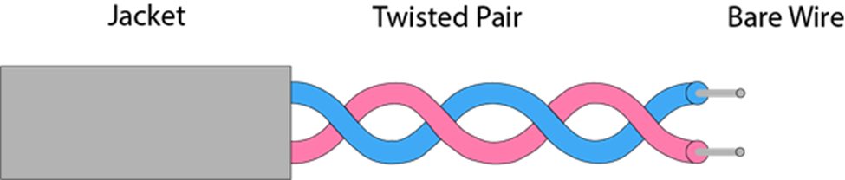
TYPES OF GUIDED MEDIA:
Twisted pair:
Consists pair of cables twisted with each other.
cheap.
Installation is easy
The frequency ranges from 0 to 3.5KHz.
consists of two insulated copper wires arranged in a regular spiral pattern.
Level of reduction in noise interference is determined by the number of turns per foot.

Slide 11
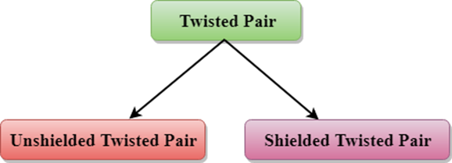
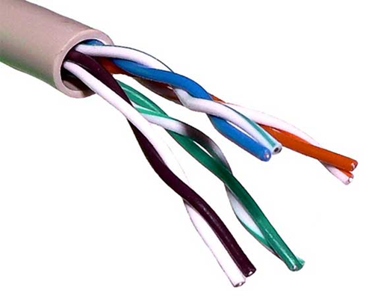
TYPES OF TWISTED PAIR:

Slide 12
UNSHIELDED TWISTED PAIR(UTP)
UTP cables consist of pairs of insulated copper wires twisted together.
used in Ethernet networks for short to medium-distance connections, such as those found in offices and homes.
Advantages Of Unshielded Twisted Pair:
It is cheap.
Installation is easy.
can be used for high-speed LAN.
Disadvantage:
can only be used for shorter distances.

Slide 13
SHIELDED TWISTED PAIR(STP )
additional metal shielding around the twisted pairs to reduce electromagnetic interference.
used in environments with high levels of electromagnetic interference.
CHARACTERISTICS OF SHIELDED TWISTED PAIR:
The cost is not very high and not very low.
installation of STP is easy.
higher capacity as compared to unshielded twisted pair cable.
higher attenuation.
shielded providing the higher data transmission rate.

Slide 14
Disadvantages
more expensive as compared to UTP and coaxial cable.
higher attenuation rate.

Slide 15
COAXIAL CABLE
contains two conductors parallel to each other.
COMPONENTS
The inner conductor is made up of copper.
the outer conductor is made up of copper mesh.
The middle core is made up of non-conductive cover that separates the inner conductor from the outer conductor. responsible for the data transferring
copper mesh prevents Electromagnetic interference.
Cable antenna TV wire is usually a coaxial cable.

Slide 16
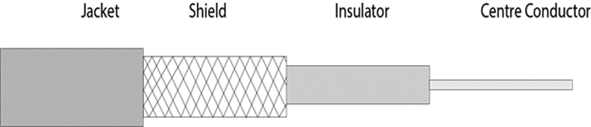
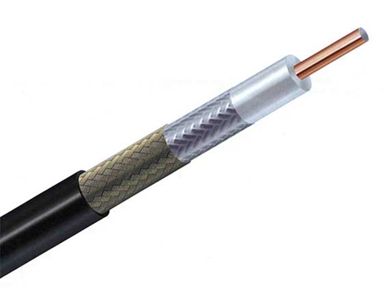

Slide 17
TYPES OF COAXIAL CABLES
Baseband transmission:
process of transmitting a single signal at high speed.
Broadband transmission:
process of transmitting multiple signals simultaneously.

Slide 18
Advantages Of Coaxial cable:
transmission at high speeds.
better shielding .
provides higher bandwidth.
Disadvantages Of Coaxial cable:
more expensive.
If any fault occurs in the cable causes the failure in the entire network.

Slide 19
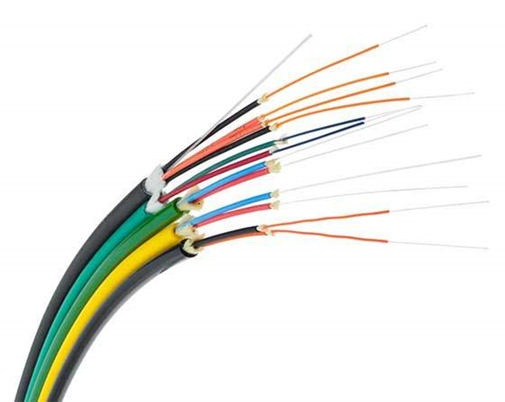
FIBRE OPTIC
uses electrical signals for communication.
holds the optical fibres coated in plastic that are used to send the data as pulses of light.
The plastic coating protects the optical fibres from heat, cold, electromagnetic interference from other types of wiring.
faster data transmissions than copper wires.

Slide 20
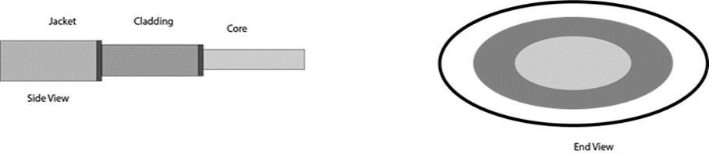

Slide 21
BASIC ELEMENTS OF FIBRE OPTIC CABLE
Core: narrow strand of glass or plastic.
Its a light transmission area.
Cladding: concentric layer of glass.
It provide the lower refractive index at the core interface as to cause the reflection within the core so that the light waves are transmitted through the fibre.
Jacket: protective coating consisting of plastic.
it preserve the fibre strength, absorb shock and extra fibre protection.

Slide 22
Advantages of fibre optic cable
Greater Bandwidth: provides more bandwidth.
Faster speed: carries the data in the form of light.
Longer distances: carries the data at a longer distance.
Better reliability: it is immune to any temperature changes.
Thinner and Sturdier: withstand more pull pressure than copper cable.

Slide 23
UNGUIDED TRANSMISSION
transmits the electromagnetic waves without using any physical medium.( wireless transmission.)
air is the media through which the electromagnetic energy can flow easily.
THREE CATEGORIES:
Radio waves
Microwaves
infrared

Slide 24
RADIO WAVES
electromagnetic waves that are transmitted in all the directions of free space(Omni-directional) .
The range in frequencies is from 3Khz to 1 khz.
the sending and receiving antenna are not aligned.
Applications Of Radio waves
for multicasting when there is one sender and many receivers.
Examples include FM radio, television, cordless phones

Slide 25
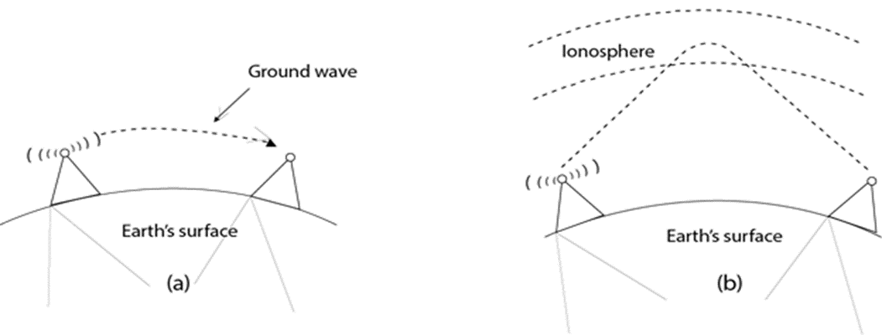

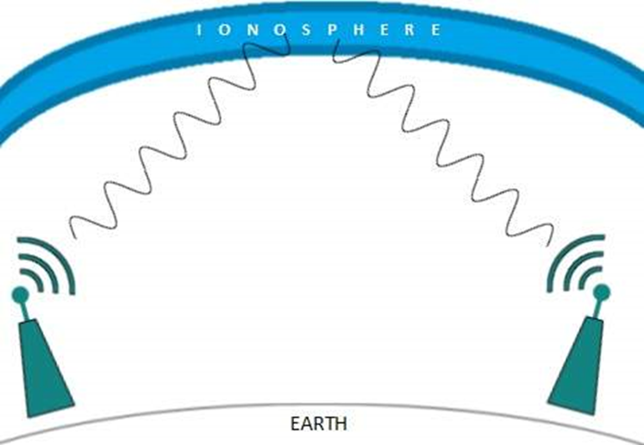

Slide 26
Advantages Of Radio transmission:
used for wide area networks and mobile cellular phones.
cover a large area, and can penetrate the walls.
provides a higher transmission rate.

Slide 27
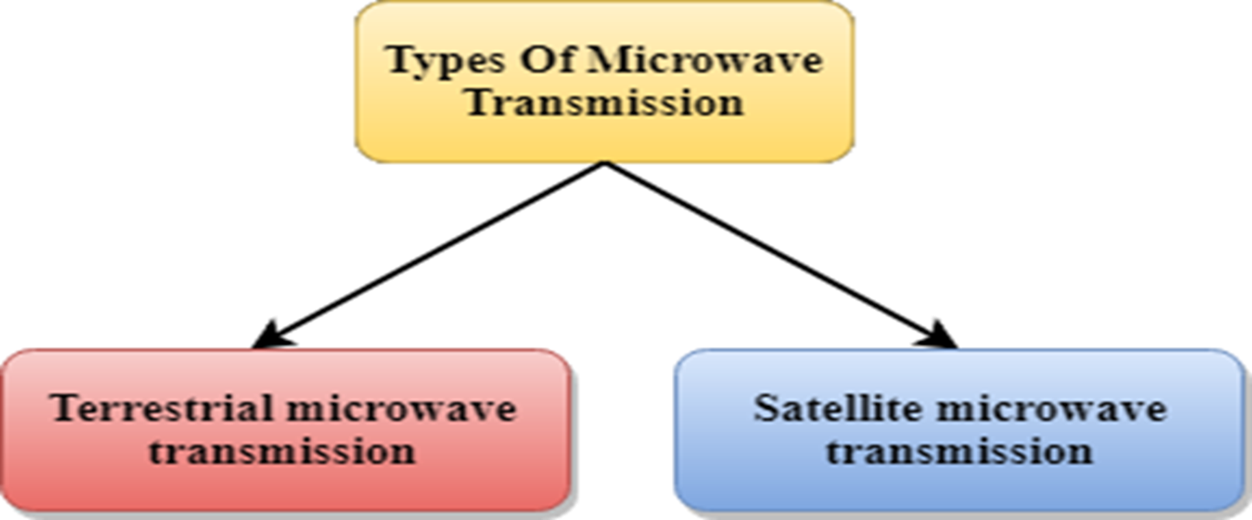
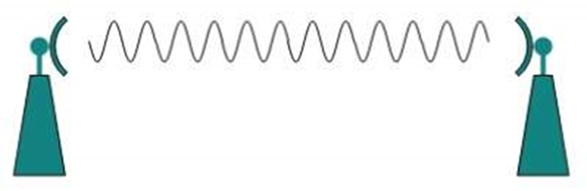
MICROWAVES
involves transmitting data using high-frequency radio waves.
used for point-to-point communication links, such as those in microwave relay systems.
two types:
Terrestrial microwave
Satellite microwave communication.

Slide 28
TERRESTRIAL MICROWAVE TRANSMISSION
transmits the focused beam of a radio signal from one ground-based microwave transmission antenna to another.
frequency ranges from 1GHz to 1000 GHz.
unidirectional as the sending and receiving antenna is to be aligned.
antennas are mounted on the towers to send a beam to another antenna which is kilometers away.
It operates on line of sight transmission meaning the antennas mounted on the towers are in the direct sight of each other.

Slide 29
CHARACTERISTICS OF MICROWAVE
Frequency range: from 4-6 GHz to 21-23 GHz.
Bandwidth: from 1 to 10 Mbps.
Short distance: It is not expensive for short distance.
Long distance: It is expensive as it requires a higher tower for a longer distance.
Attenuation: It is affected by environmental conditions and antenna size.

Slide 30
Advantages Of Microwave
cheap.
does not require any land for the installation of cables.
provides an easy communication in terrains.
Communication over oceans can be achieved.

Slide 31
DISADVANTAGES OF MICROWAVE TRANSMISSION
Eavesdropping: Any malicious user can catch the signal in the air by using its own antenna.
Out of phase signal: A signal can be moved out of phase.
Susceptible to weather condition: affected by changes in weather condition.
Bandwidth limited: Allocation of bandwidth is limited in the case of microwave transmission.

Slide 32
SATELLITE MICROWAVE COMMUNICATION
physical object that revolves around the earth at a known height.
more reliable as it offers more flexibility than cable and fibre optic systems.
We can communicate with any point on the globe by using satellite communication.

Slide 33
HOW DOES SATELLITE WORK?
It accepts the signal that is transmitted from the earth station, and it amplifies the signal.
The amplified signal is retransmitted to another earth station.

Slide 34
ADVANTAGES OF SATELLITE MICROWAVE COMMUNICATION
The coverage area big
The transmission cost of the satellite is independent of the distance from the centre of the coverage area.
used in mobile and wireless communication applications.
It is easy to install.
used in a wide variety of applications such as weather forecasting, radio/TV signal broadcasting, mobile communication.

Slide 35
DISADVANTAGES OF SATELLITE MICROWAVE COMMUNICATION:
designing and development requires more time and higher cost.
needs to be monitored and controlled on regular periods so that it remains in orbit.
The life of the satellite is about 12-15 years.

Slide 36
Infrared
used for communication over short ranges.
The frequency ranges from 300 GHz to 400 THz.
It is used for short-range communication such as data transfer between two cell phones, TV remote operation, data transfer between a computer and cell phone resides in the same closed area.

Slide 37
CHARACTERISTICS OF INFRARED
It supports high bandwidth, and hence the data rate will be very high.
cannot penetrate the walls.
provides better security with minimum interference.
unreliable outside the building.

Slide 38
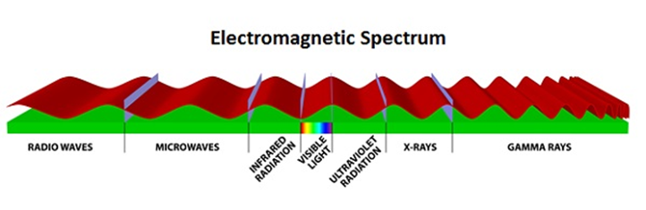

Slide 39
THANK YOU FOR YOUR TIME !!!!!!!!!!!!!!

Slide 40
To do
What is transmission media
Explain the types of transmission media

